Slide 1
Introduction to Local Management
Notes:
This presentation is intended for a longer discussion than the “Executive Audience” presentation for a primarily business-side/management audience and agenda. It retains a lot of the same “why” explanations and covers more product detail, still at the mostly conceptual level.

Slide 2
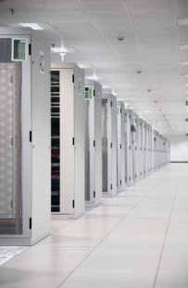
Local Management
A management practice founded in the most extreme locations, honed in the enterprise, and now in demand everywhere the network is critical.
You need Local Management to reduce cost and protect the security of your company and customers.
Notes:
MESSAGE: Uplogix is a mature and field tested solution gaining broad adoption by enterprise buyers.
The basic concept of Local management was devised to meet the needs of organizations and scenarios where site visits by network technicians were not only expensive but sometimes dangerous or not feasible at all. The result is an extremely reliable solution that meets or exceeds enterprise requirements while delivering the same benefits cost effectively.

Slide 3
You should care about Local Management
The battle of the Enterprise network has only just begun…
Today, OPEX is the largest IT expense for your distributed infrastructure (about 50% of the total)
Why? The answer to solving network problems is to send people onsite.
Costs are going to soar as Virtualization, Cloud computing and SaaS escalate network demands
Why? When everyone and everything is distributed (people, data, apps), a bulletproof network is critical
The myth of network security is that there is any when the network goes down
Why? That contractor going out to fix the network has root level passwords, and you can’t see what he’s doing
End the Status Quo
For just a couple of thousand dollars per site, Uplogix cuts your OPEX in half and limits current security risks
Notes:
MESSAGE: Network Management is broken, being done wrong imitating inappropriate server management approaches.
Even though the devices making up the networking infrastructure are no more complex or greater in number than other infrastructure components, they consume more of IT’s resources to maintain, represent a greater security challenge, generally must be configured in fault tolerant/redundant deployments, and it is only getting worse.
The reason for all of this is that Network Management tools severely lag other management disciplines. The core cause is that management architectures developed for servers and storage infrastructure that emphasize centralized management over the network are improperly applied to network devices which ARE the network and therefore must be managed out of band. Uplogix Local Management provides real enterprise class management for network and communications devices.

Slide 4
What is Local Management?
A Virtual Technician in a Box A management platform located with and directly connected to managed devices, complementing centralized management tools
Uplogix Delivers
Remote Access Cost effective and reliable with multiple OOB channel options
Access Control and Complete Audit Fine grained role-based access for administration with no network dependence for AAA or audit
Configuration Management Fail-safe automated changes and updates. Common interface for heterogeneous environments.
Automated On-Site Support Automate tasks normally requiring an on-site technician
High Resolution Monitoring More intensive network independent without reliance on SNMP MIBs.
Centralized Control and Reporting Integration with centralized management systems
Notes:
PURPOSE: (a) Stake value claim (b) Tell them right off what we are
Uplogix is the local component of a robust systems management architecture. Uplogix was designed from day 1 to provide critical management services locally from it’s own dedicated and specialized hardware platform.
By Extension of Management Basics to Network Devices, what we mean is that for the first time some of the core benefits that IT organizations gained in managing servers from implementing centralized management systems are extended, by Uplogix, to network devices, specifically:
Consistent administrative interface is heterogeneous environments – for many common tasks technicians can learn Uplogix commands once, as opposed to having to learn the unique commands required for each different brand of device.
Secure role based administrative access – give administrators the appropriate access they need to do their jobs and no more in a way that is easy to manage itself.
Local network and systems management includes management tasks better performed locally from the following management disciplines:
Configuration Management
Security and Compliance Management
Performance and Availability Management

Slide 5
Why Do Customers Use Uplogix?
Uplogix provides an automated virtual presence onsite with 24/7 access both in-band and out-of-band.
Ask the Admin
Ask the IT Director
Monitor, diagnose AND TAKE ACTION in an automated fashion
Resolve problems in minutes vs. hours or days, automate the tedious and error prone
Manage network devices WITHOUT using the network
Polls intensively across the console; provides information proactively
Virtual crash cart with local data storage
Reduce OPEX & truck rolls and increase uptime & visibility
Improve Service Levels
Detect problems faster, resolve many immediately and automatically
Improve Security and Compliance
Decrease mean time to innocence; remove finger pointing
Audit trail due to logging of all actions
Notes:
MESSAGE: Uplogix provides value to end users, which enhances adoptability, and to the business.
Technicians and Network Administrators should view Uplogix as a way to allow them to get more done with less risk. The system focused on automating tedious and mundane tasks allowing technicians to focus on more high impact and complex issues and opportunities. The likelihood of a mistake causing an outage is greatly reduced.
The organizational benefits include:
The ability to support growing networks or networks and/or increasingly stringent service levels without adding personnel
Reduced travel or third party support costs
Overall better responsiveness and improved uptime with potentially less need for redundant infrastructure, improving relationships with customers (internal or external)
Assured and demonstrable regulatory compliance
Internal efficiency and reduced conflict via more effective diagnosis of the source of problems when detected (improved mean-time-to-innocence).

Slide 6
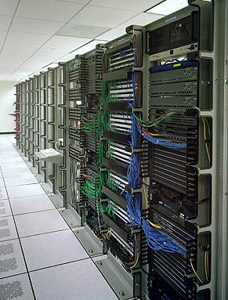
Uplogix Company Profile
We help our customers improve and modernize their management architecture with our patented local management solution. This reduces OPEX, increases security and improves service levels.
Large, Diverse and World Wide Customer Base
Headquartered in Austin, Texas
Global 24x7 support
Key Partners: Cisco, Sun, IBM, iDirect, WWT
Notes:
MESSAGE: We are an established, stable vendor with experience working in a variety of applications, plugged into the right partner ecosystem.
Summary slide, that also summarizes the organization they would be working with. We not a new company speculating about the market we serve have lots of real world experience to prove it.
6

