Slide 1
Local Management Platform
Notes:
This presentation is intended for a longer discussion than the “Executive Audience” presentation for a primarily business-side/management audience and agenda. It retains a lot of the same “why” explanations and covers more product detail, still at the mostly conceptual level.

Slide 2

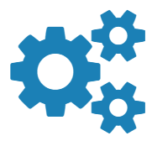
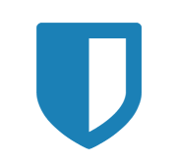
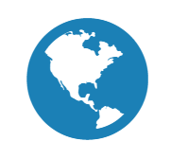
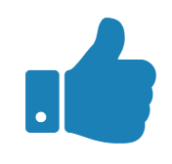

Go beyond out-of-band
Uplogix is the most evolved out-of-band solution
SMARTEN UP
ARMOR UP
LINK UP
KEEP UP
AUTOMATION
SECURITY
ACCESS
PROVEN
Founded in 2005; Austin, TX
250+ clients; all verticals
Battle tested

Slide 3
















































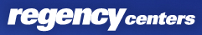

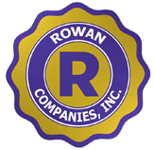




















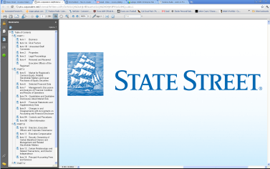
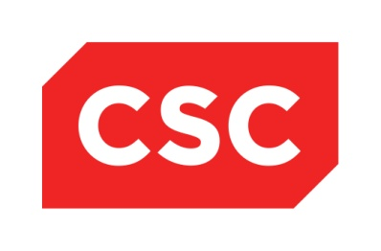
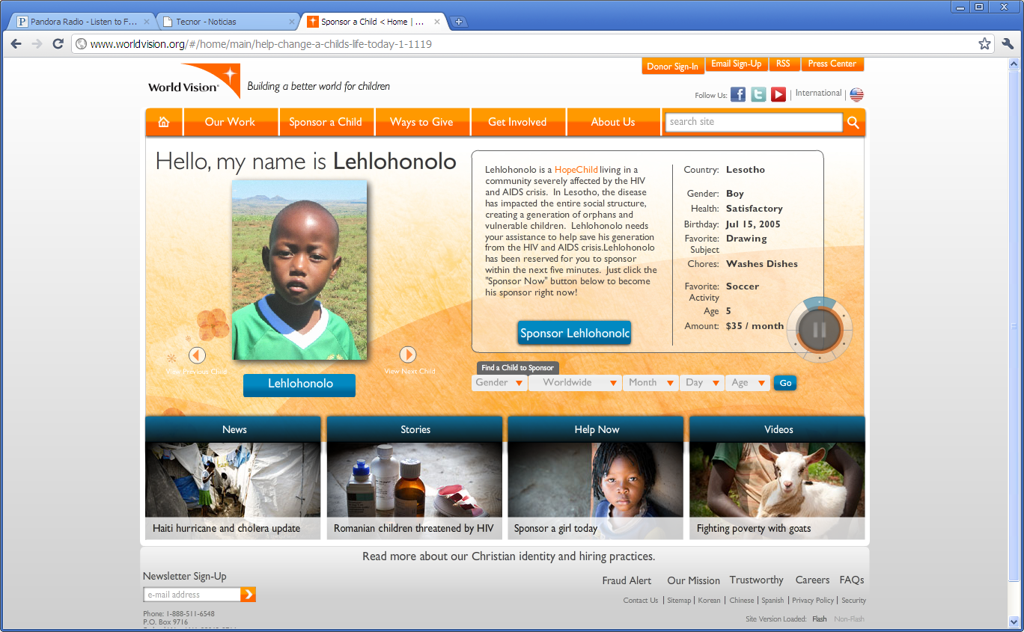
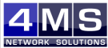
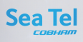




















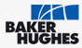




Who is “Going Local” with Uplogix?
Financial Services | Mfg. & Retail | MSP & Outsourcing | Healthcare & Enterprise | Government | Education & Non-Profit | Satellite | Energy

Slide 4
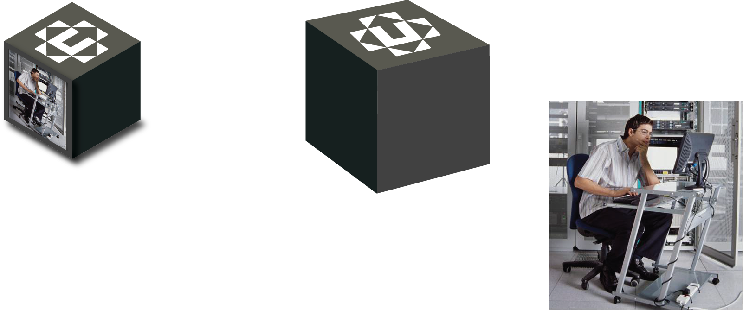
Elevate your expectations for out-of-band
A virtual technician in a box
Like an admin with a crash cart, Uplogix is directly connected to managed devices, continuously monitoring and taking run book actions. We take you beyond out-of-band:
  To higher levels of performance & reliability
  Network problems are identified, isolated and solved automatically before you even knew there was a problem
  Away from the pain and hassle of routine updates and config changes
  Our automated configuration safety net lets you confidently make changes remotely on one device, or many
  Out of the danger zone
  Secure encryption and access protects against internal and external threats
  Off the road
  A wide variety of out-of-band options including LTE cellular modems that can serve as an automated failover network for your primary traffic

Slide 5



Current approaches to network management don’t scale for increasing demands
Network management tools depend on the network, limiting value to reporting-only, instead of diagnosing problems or taking automated actions
Complex and distributed networks (that are only going to get worse with Cloud and IoT)
Limited and expensive personnel resources
In-band (software) tools cannot address over 40% of network problems and security threats
51% of network outages are caused by human error
US companies spend over $25B annually on network support personnel

Slide 6
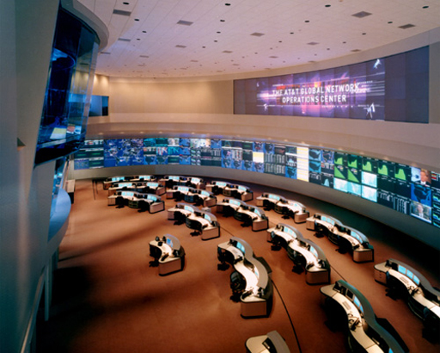
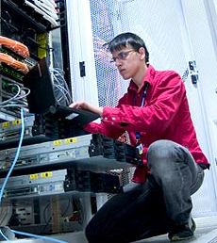

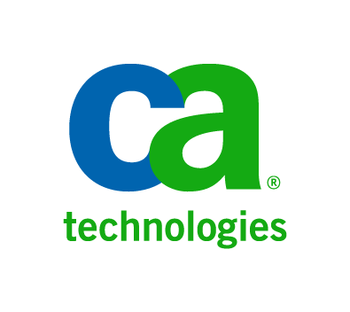







Many centralized management tools in the NOC; but when it comes to taking action it’s all people
Centralized – NOC
Remote – Field
Network management requires both
Network dependent, which is a fundamental limitation
Focused on strong reporting, discovery and dashboard, not taking actions
Automation over the network isn’t reliable, people take all the actions
Not reliant on the network
  Directly connected to devices
  Automated & reliable corrective actions
  Failover path for management and critical traffic
  Reduces need to send people into the field

Slide 7
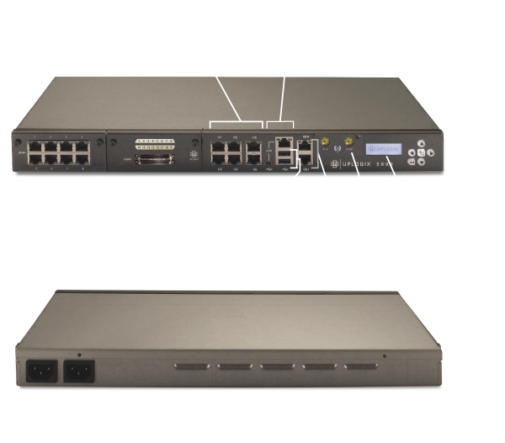
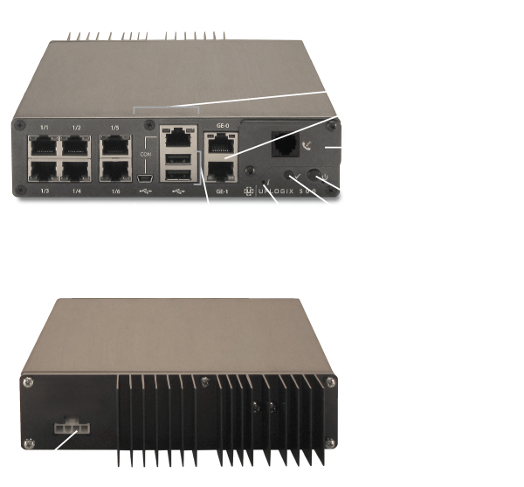
How do we do it?
Think console server on steroids
UPLOGIX 5000
UPLOGIX 500

Slide 8











Uplogix in your Enterprise
Wide Area Network
Network Operations Center
Data Center or
Branch Office
Centralized Network
Management Tools
Router
WAN Accelerator
Power
Distribution
Unit
Switch
Uplogix
Control Center
Other Device(s)
Polling every
30 seconds
Uplogix
Local Manager
WAN Traffic Failover
over Uplogix OOB
Out-of-band options:
POTS, Cellular,
Satellite, Ethernet

Slide 9
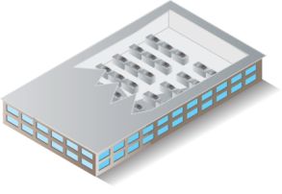
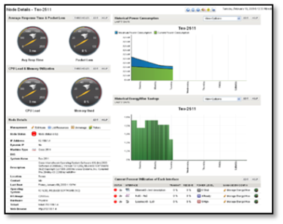
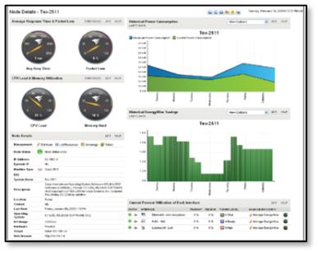



Uplogix in your Enterprise –
Monitoring and Automated Remediation
DETECTED (within 30 seconds):
> Frame loss seconds INCREMENTING
> Interface operational state is UP
> Interface Protocol State is DOWN
BEGIN AUTOMATED RUNBOOK ACTIONS:
Clear Service Module
Cycle Interface
Pull show tech
BRING IN ADDITIONAL INFORMATION FOR DECISION MAKING:
  > VoIP test fails
  > HTTP traffic fails
  > TCP SYN-ACK fail
Reboot
Cycle Power
> Interface protocol state is UP
> Frame loss seconds CLEARED
> Interface operational state UP
DETECTED (within 30 seconds):
> Frame loss seconds INCREMENTING
> Interface operational state is UP
> Interface Protocol State is DOWN
BEGIN AUTOMATED RUNBOOK ACTIONS:
Clear Service Module
Cycle Interface
Pull show tech
BRING IN ADDITIONAL INFORMATION FOR DECISION MAKING:
  > VoIP test fails
  > HTTP traffic fails
  > TCP SYN-ACK fail
Reboot
Cycle Power
> Interface protocol state is UP
> Frame loss seconds CLEARED
> Interface operational state UP
INTERNET
Wide Area Network
Data Center(s) or
Branch Office(s)
Network Operations Center
Router
Secondary Network Connection
Over Uplogix OOB
(up to 50 Mbps)
WAN Accelerator
Power
Distribution
Unit
Switch
Uplogix Control Center
Other Device(s)
Monitoring directly over the console port, not the network
(like an onsite technician)
Monitoring 10x more frequently, gathering richer data
In an outage takes automatic recovery actions within seconds
Plus backfill centralized tools over an out-of-band link
Uplogix
Local Manager
Out-of-band options:
POTS, Cellular,
Satellite, Ethernet

Slide 10



Service Level Verification
Wide Area Network
Point to Point Test:
Simulated User
VoIP quality
HTTP & TCP/IP performance
Network Operations Center
Dashboard
Fault Management
Config. Management
Network Management
Trouble Ticketing & RBA
Wide Area Network
Uplogix
Control Center

Slide 11





Dramatically Improve Service Levels
The Road to Recovery
UNKNOWN
IDENTIFICATION
ISOLATION
RESOLUTION
EVENT
RECOVERY
Standard NSM Tools
SLA Timer Starts
UNKNOWN
IDENTIFICATION
ISOLATION
RESOLUTION
0:00 min
5:00
10:00
15:00
minutes or hours
minutes or hours
hours or days
Detection through
polling and verification
Administrator begins fault isolation and resolutions attempt, or places service call
Tech arrives
on-site
With Uplogix
COMPLIANCE
With Standard NSM: Days or weeks, compliance is missing or requires manual research
UNKNOWN
IDENTIFICATION
ISOLATION
RESOLUTION
0:00
0:30
1:00
1:30
2:00
2:30
3:00 minutes
With Uplogix:
At all times, all actions stored for
compliance reporting
Problem detected from local polling every 30 sec.
L1 & L2 run book actions automated,
NOC notified, device recovered or escalated

Slide 12
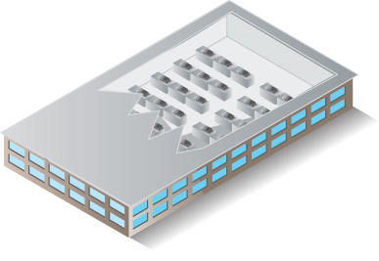
Uplogix in your Enterprise –
WAN Traffic Failover (WTF)
?!?!
: >)
Wide Area Network
USERS
: >)
Network Operations Center
Data Center(s) or
Branch Office(s)
Centralized Network
Management Tools
Router
WAN Accelerator
Power
Distribution
Unit
Secondary Network
Connection
Over Uplogix OOB
Switch
Uplogix Control Center
Primary WAN connection goes down, detected by router which changes route through Uplogix
Uplogix brings up out-of-band connection, forwards router traffic
Users remain connected, Uplogix populates dashboard in the NOC with alerts to the problem as well as providing troubleshooting information and support access
Other Device(s)
Uplogix
Local Manager
Out-of-band options:
POTS, Cellular,
Satellite, Ethernet

Slide 13
Uplogix in your Enterprise –
Efficient Configuration and Change
Step 1: Select a Cisco IOS Software Image.
Step 2: Download the Cisco IOS Software
image to the Uplogix Control Center.
Step 3: Schedule the job.
Cisco procedures that are automated:
Step 3: Identify the File System to Copy the Image
Step 4: Prepare for the Upgrade
Step 5: Verify that the TFTP Server has IP Connectivity
to the Router
Step 6: Copy IOS Image to the Router
Step 7: Verify the Cisco IOS Image in the File System
Step 8: Verify the Configuration Register
Step 9: Verify the Boot Variable
Step 10: Save the Configuration and Reload the Router
Step 11: Verify the Cisco IOS Upgrade
Wide Area Network
Data Center(s) or
Branch Office(s)
Network Operations Center
Router
Dashboard
Fault Management
WAN Accelerator
Power
Distribution
Unit
Config. Management
Switch
Network Management
Trouble Ticketing & RBA
Other Device(s)
Uplogix
Local Manager
Uplogix
Control Center
Out-of-band options:
POTS, Cellular,
Satellite, Ethernet

Slide 14

Uplogix in your Enterprise –
Safe Configuration and Change
Wide Area Network
Data Center(s) or
Branch Office(s)
Network Operations Center
Network Operations Center
Running
Config
Router
Running
Config
Dashboard
Fault Management
WAN Accelerator
Config. Management
Power
Distribution
Unit
Network Management
Switch
Trouble Ticketing & RBA
Other Device(s)
Requests
Terminal Session
Confirm changes
Yes No
More Time
Uplogix
Control Center
Roll back
changes
Running
Config
Previous
Running
Config
Uplogix
Local Manager
DIFF
Surgical
Rollback
Inactivity Timer Starts

Slide 15
Uplogix in your Enterprise –
Secure Remote Access
Wide Area Network
Data Center(s) or
Branch Office(s)
Network Operations Center
Dashboard
Router
Fault Management
Config. Management
WAN Accelerator
Power
Distribution
Unit
Network Management
Switch
Trouble Ticketing & RBA
Other Device(s)
Uplogix
Control Center
Secure
Out-of-band
Connection
Uplogix
Local Manager
Out-of-band options:
POTS, Cellular,
Satellite, Ethernet

Slide 16
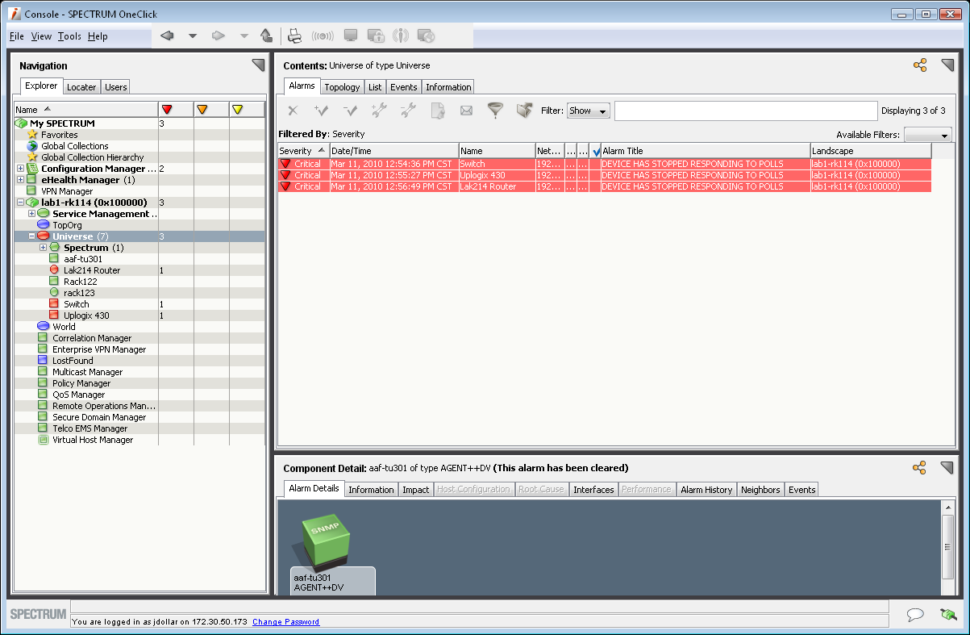
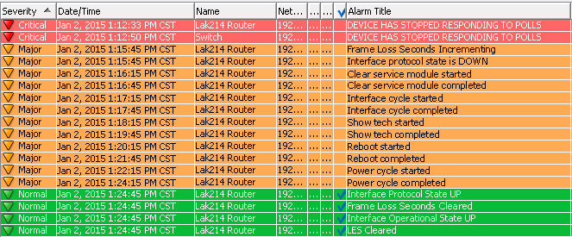
Uplogix in your Enterprise –
Working with NSM
Wide Area Network
Data Center(s) or
Branch Office(s)
Network Operations Center
Dashboard
Router
Fault Management
Config. Management
WAN Accelerator
Power
Distribution
Unit
Network Management
Switch
Trouble Ticketing & RBA
Other Device(s)
Uplogix
Control Center
Secure
Out-of-band
Connection
Uplogix
Local Manager
Out-of-band options:
POTS, Cellular,
Satellite, Ethernet

Slide 17

Survivable Logging and AAA
Network-independent role-based
management access
  Extend granular management policies to
  network devices and remote access
  TACACS/RADIUS integration in/out-of-band
  with offline caching
Network-independent authorization, audit & logging
  Remove shared passwords
  Maintain regulatory compliance regardless of the network state (e.g. PCI, SOX, HIPAA)
  Independent SLA validation of business applications
Secure access
  SSHv2 access with optional IPSec
  Out-of-band uses dial-from remote to reduce war-dialing endpoints

Slide 18
Uplogix Control Center
Central Control for the Enterprise
Wide Area Network
Network Operations Center
Data Center or
Branch Office
Dashboard
Router
Fault Management
Config. Management
WAN Accelerator
Power
Distribution
Unit
Network Management
Switch
Trouble Ticketing & RBA
Other Device(s)
Polling every
30 seconds
Uplogix
Control Center
Uplogix
Local Manager
Out-of-band options:
POTS, Cellular,
Satellite, Ethernet

Slide 19


Uplogix Control Center
Central Control for the Enterprise
Centralized Control
Element manager for Uplogix Local Managers:
  Grouping of similar sites for easier deployment
  Device management
  User management
  Label/tag end devices
  Push data & rules to all appliances

Slide 20
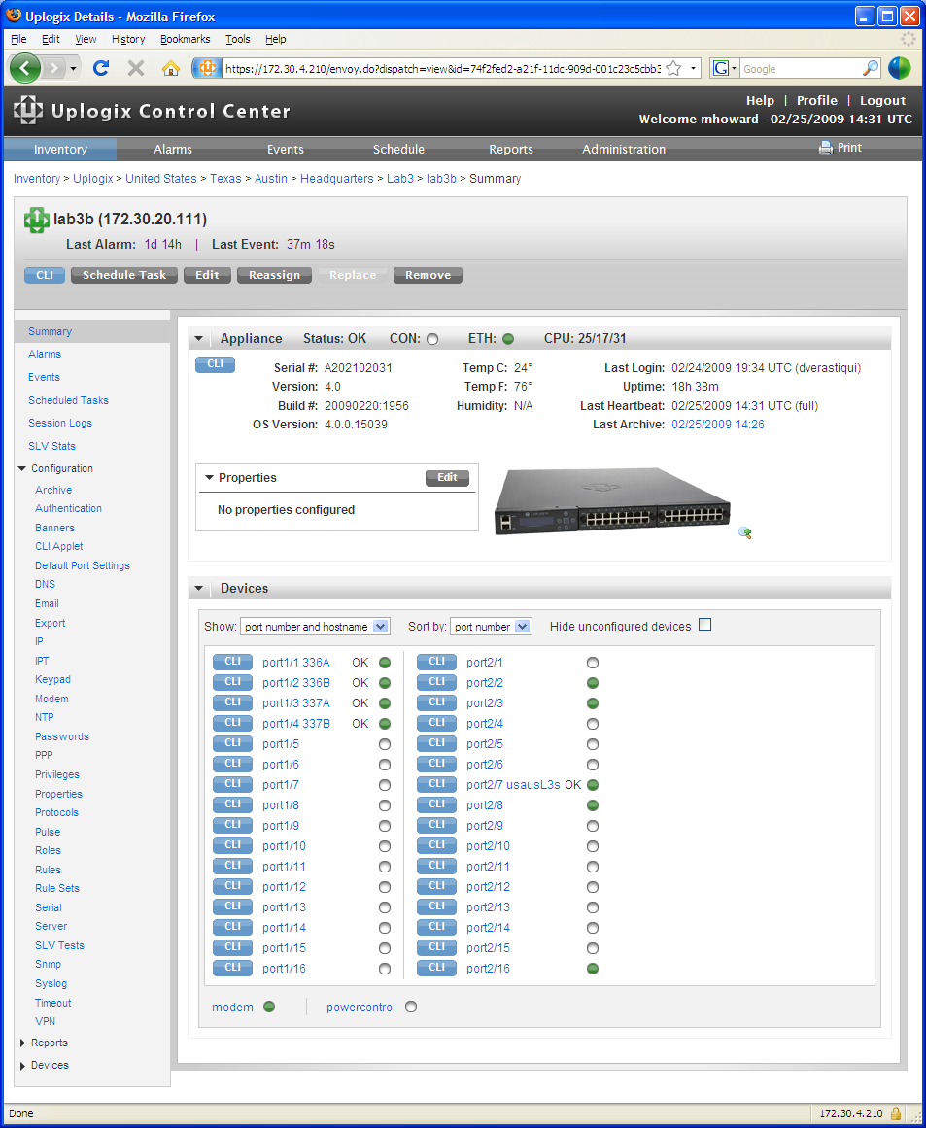
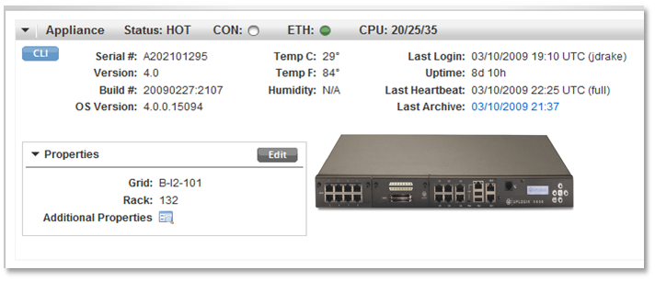
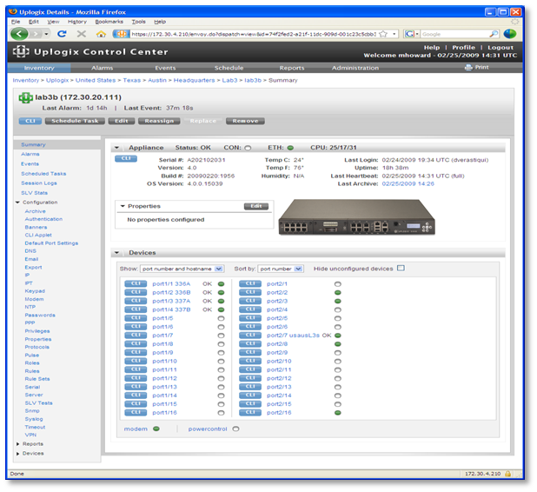
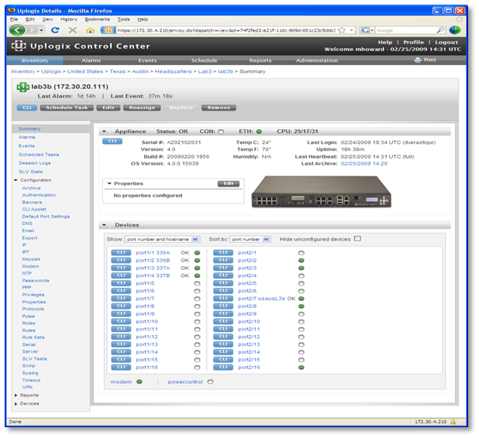

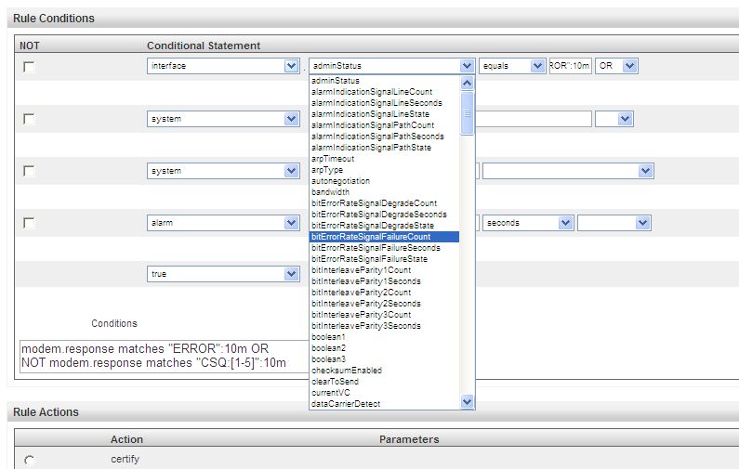
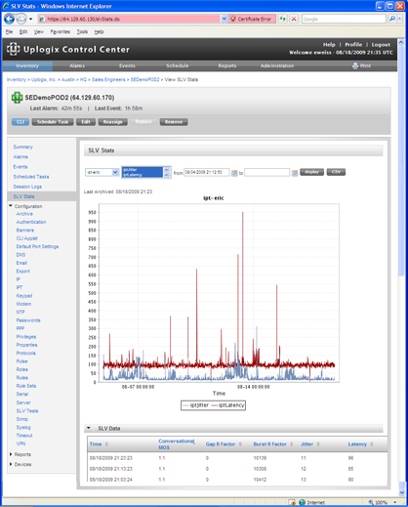
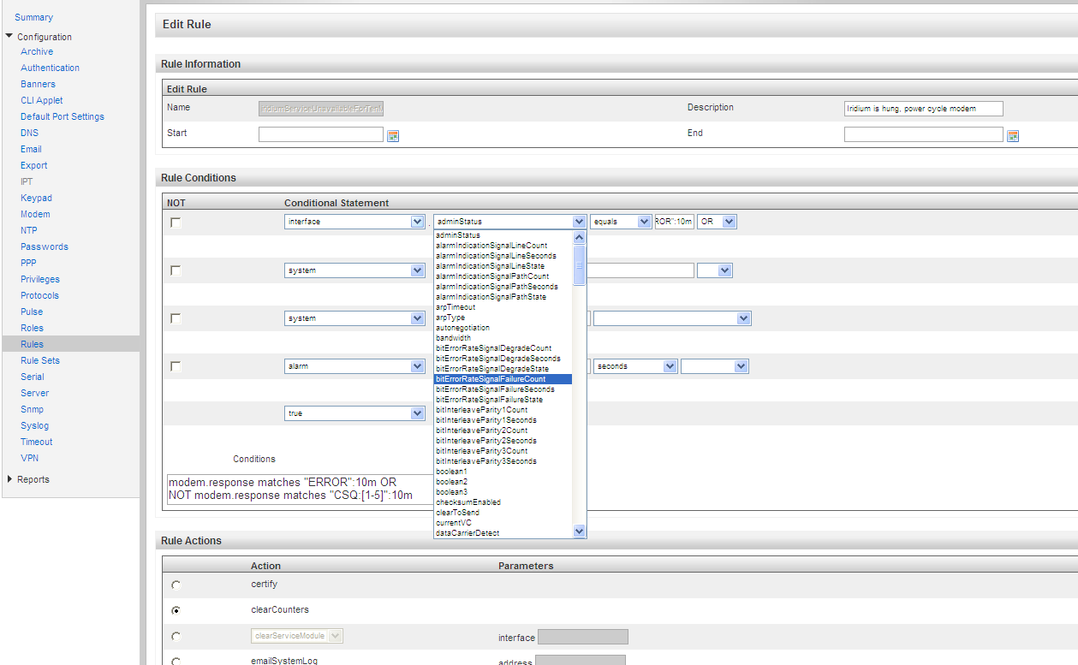

Uplogix Control Center
Central Control for the Enterprise
Centralized Control for LMS
Web-based GUI
  Real time data for
  Uplogix Local Managers and
  managed devices
  Granular authorization
  Easy creation and
  modification of rules
  Browse logs and SLV tests
Alarm & trap manager
Reporting & audit engine
SOX
PCIDSS
HIPAA
Dashboard
NERC/FERC
Fault Management
FISMA
Config. Management
GLBA
Network Management
Trouble Ticketing & RBA

Slide 21
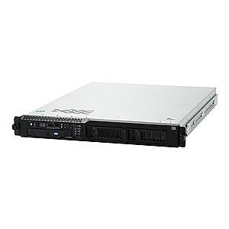

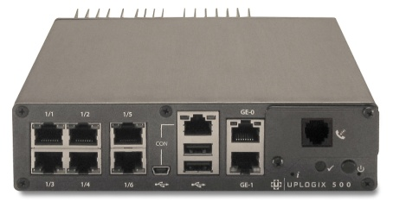
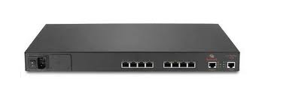
Uplogix Local Managers
Don’t manage the network over the network.
Uplogix LMS, robust management software innovatively and thoroughly exploits physical proximity
Platform combines elements of different hardware types into one device designed for collocated connection
+
+
=
Console Server
Remote OOB Access (modem)
Direct Device Connection
Management Server
(Intel Atom, 40GB storage)
Local Management Software
Uplogix Local Manager

Slide 22
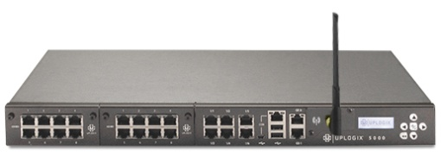
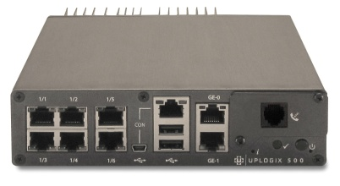
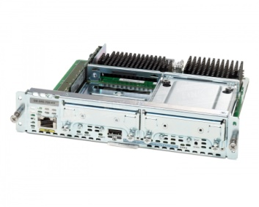
Flexible Deployment Options:
Purpose Built or Software Solution
Uplogix 5000
  Ideal for datacenters and expanding infrastructures
  Manage up to 22 devices (including a power controller)
Uplogix 500
  Ideal for branch offices
  Manage up to 6 devices (including a power controller)
Uplogix on Cisco
  Gain full Local Management functionality on Cisco Integrated Services Routers with support for UCS Express Modules (SRE 710 or SRE 910)
LMS Software
  Virtual LMS on your servers
  Exploit in-place console servers
  Virtual UCC

Slide 23
Summary
Empower existing IT staff
to manage growing environments, maintain service levels and improve security as IT infrastructures become more network sensitive
Directly connected
See more than SNMP, more reliably and without impacting the network at all (poll intensively)
Fail-safes change completely so you can do more, automate more, more often & without worry
Flexible automation
through the same CLI access technicians use – robust change processes and run book automations, no limitations
Extends role-based management access and detailed “always” on audit to network devices
Complements and improves existing centralized network management tools for better performance, reliability and expanded capabilities

Slide 24
Uplogix Local Management Platform
Thank You

